Slide 1
Introduction to
Computer Architecture
CSE 302 – Computer Architecture

Slide 2
Welcome to CSE 302
Instructor: Prof. Md. Mahbubul Alam Joarder Ph.D.
Office: IIT Building, Room 301
Office Phone: 8674
Email:
  joarder@univdhaka.edu, joarder@du.ac.bd

Slide 3
Grading Policy
Quizzes (Minimum 2) 20%
Class Performance 10%
MIPS Programming 15%
Midterm Exam I 15%
Midterm Exam II 20%
Final Exam 20%
==============================
100%

Slide 4
Late Policy, Attendance, & Makeup
Late project is accepted up to 3 days late
  But will be penalized 5% for each late day
Attendance will be taken at the beginning of each lecture
  Official / medical excuses must be presented within one week
Late attendance is counted as half presence
  Two late attendances are counted as one absence
No makeup exam will be given for missing exam or quiz

Slide 5
Software Tools
MIPS Simulators
  MARS: MIPS Assembly and Runtime Simulator
    Runs MIPS-32 assembly language programs
    Website: http://courses.missouristate.edu/KenVollmar/MARS/
CPU Design and Simulation Tool
  Logisim
    Educational tool for designing and simulating CPUs
    Website: http://ozark.hendrix.edu/~burch/logisim/

Slide 6
Why Study Computer Architecture?
You want to be called “Computer Engineer or Scientist”
You want to become an “expert” on computer hardware
You want to become a “computer system designer”
You want to become a “software designer” and need to understand how to improve code performance
Technology is improving rapidly ⇒ new opportunities
Has never been more exciting!
Impacts Electrical Engineering and Computer Science

Slide 7
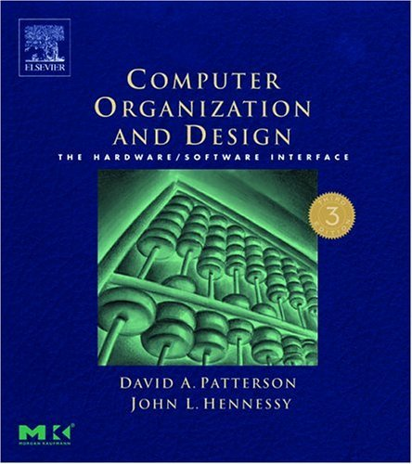
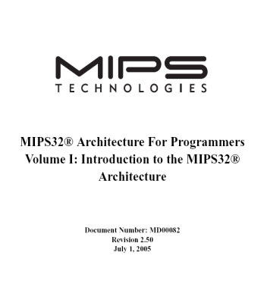
Which Books will be Used?
Computer Organization & Design
The Hardware/Software Interface
  David Patterson and John Hennessy
  Morgan Kaufmann Publishers
  Third Edition (2005)
  Read the textbook in addition to the course slides
References: MIPS32 Architecture
  Volumes I, II, and III are available online

Slide 8
Course Objectives
Understand modern computers, their evolution, and trade-offs at the HW/SW interface
  Instruction Set Architecture
  Computer Arithmetic
  Performance and Metrics
  Pipelining
Understand the design of a modern computer system
  Datapath design
  Control design
  Memory System Design
  I/O System Design
Notes:
We will take a break and talk about class philosophy.

Slide 9
Five Classic Components
Since the 1940’s, computers have 5 classic components
Input devices
  Keyboard, mouse, …
Output devices
  Display, printer, …
Storage devices
  Volatile memory devices: DRAM, SRAM, …
  Permanent storage devices: Magnetic, Optical, and Flash disks, …
Datapath
Control
Newly added 6th component: Network
  Essential component for communication in any computer system
Computer
Processor
Devices
Control
Input
Memory
Datapath
Output
Together, they are called the Processor

Slide 10
Fetch - Execute Cycle
Instruction Fetch
Fetch instruction
Compute address of next instruction
Instruction Decode
Generate control signals for instruction
Read operands from registers
Execute
Compute result value
Infinite Cycle implemented in Hardware
Memory Access
Read or write memory (load/store)
Writeback Result
Writeback result in a register

Slide 11
CPU Clocking
Operation of digital hardware is governed by a clock
Clock period
Clock (cycles)
Data transfer
and computation
Update state
Clock period: duration of a clock cycle
  e.g., 250 ps = 0.25 ns = 0.25 ×10^{–9} sec
Clock frequency (rate) = 1 / clock period
  e.g., 1/ 0.25 ×10^{–9} sec = 4.0×10⁹ Hz = 4.0 GHz

Slide 12
What is “Computer Architecture” ?
Computer Architecture =
Instruction Set Architecture +
Computer Organization
Instruction Set Architecture (ISA)
  WHAT the computer does (logical view)
Computer Organization
  HOW the ISA is implemented (physical view)
We will study both in this course

Slide 13
Instruction Set Architecture (ISA)
Is a subset of Computer Architecture
Definition by Amdahl, Blaaw, and Brooks – 1964
“… the attributes of a [computing] system as seen by the programmer, i.e. the conceptual structure and functional behavior, as distinct from the organization of the data flows and controls the logic design, and the physical implementation.”
An ISA encompasses …
  Instructions and Instruction Formats
  Data Types, Encodings, and Representations
  Programmable Storage: Registers and Memory
  Addressing Modes: Accessing Instructions and Data
  Handling Exceptional Conditions

Slide 14
Instruction Set Architecture – cont’d
Critical interface between hardware and software
  Standardizes instructions, machine language bit patterns, etc.
  Advantage: different implementations of the same architecture
  Disadvantage: sometimes prevents using new innovations
Examples (versions) Introduced in
  Intel (8086, 80386, Pentium, ...) 1978
  IBM Power (Power 2, 3, 4, 5) 1985
  HP PA-RISC (v1.1, v2.0) 1986
  MIPS (MIPS I, II, III, IV, V) 1986
  Sun Sparc (v8, v9) 1987
  Digital Alpha (v1, v3) 1992
  PowerPC (601, 604, …) 1993

Slide 15
Overview of the MIPS ISA
All instructions are 32-bit wide
Instruction Categories
  Load/Store
  Integer Arithmetic
  Jump and Branch
  Floating Point
  Memory Management
Three Instruction Formats
Registers
R0 - R31
PC
HI
LO
R-type
Op⁶
Rs⁵
Rt⁵
Rd⁵
sa⁵
funct⁶
I-type
Op⁶
Rs⁵
Rt⁵
immediate¹⁶
J-type
Op⁶
immediate²⁶

Slide 16
Computer Organization
Realization of the Instruction Set Architecture
Characteristics of principal components
  Registers, ALUs, FPUs, Caches, ...
Ways in which these components are interconnected
Information flow between components
Means by which such information flow is controlled
Register Transfer Level (RTL) description
Notes:
Design state of art organization in 1990

Slide 17
Microprocessor Organization
Front Side Bus
Intel NetBusrt Micro-Architecture
Bus Unit
Frequently used paths
Less frequently used paths
2nd Level Cache
8-way
D-Cache
4-way
Front End
Fetch &
Decode
Trace Cache
Microcode ROM
Execution
Out-of-Order Core
Retirement
BTBs / Branch Prediction
Branch History Update

Slide 18
Abstraction Layers
Application
Compiler
Software
Operating System
Assembler
Linker
Loader
Scheduler
Device Drivers
Instruction Set Architecture (Interface SW/HW)
Processor
Memory
I/O System
Datapath & Control Design
Hardware
Digital Logic Design
Circuit Design
Physical (IC Layout) Design
Abstraction hides implementation details between levels
Helps us cope with enormous complexity
ISA is at the interface between software and hardware

Slide 19
Technology Improvements
Year | Technology | Relative performance/cost
1951 | Vacuum tube | 1
1965 | Transistor | 35
1975 | Integrated circuit (IC) | 900
1995 | Very large scale IC (VLSI) | 2,400,000
2005 | Ultra large scale IC | 6,200,000,000
Processor transistor count: about 30% to 40% per year
Memory capacity: about 60% per year (4x every 3 years)
Disk capacity: about 60% per year
Opportunities for new applications
Better organizations and designs

Slide 20
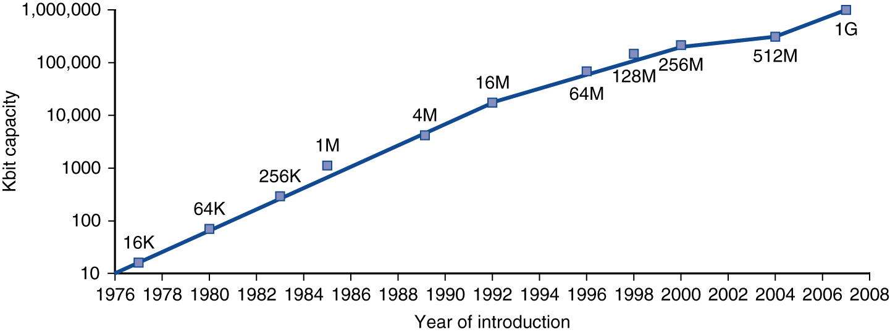
Growth of Capacity per DRAM Chip
DRAM capacity quadrupled almost every 3 years
  60% increase per year, for 20 years

Slide 21
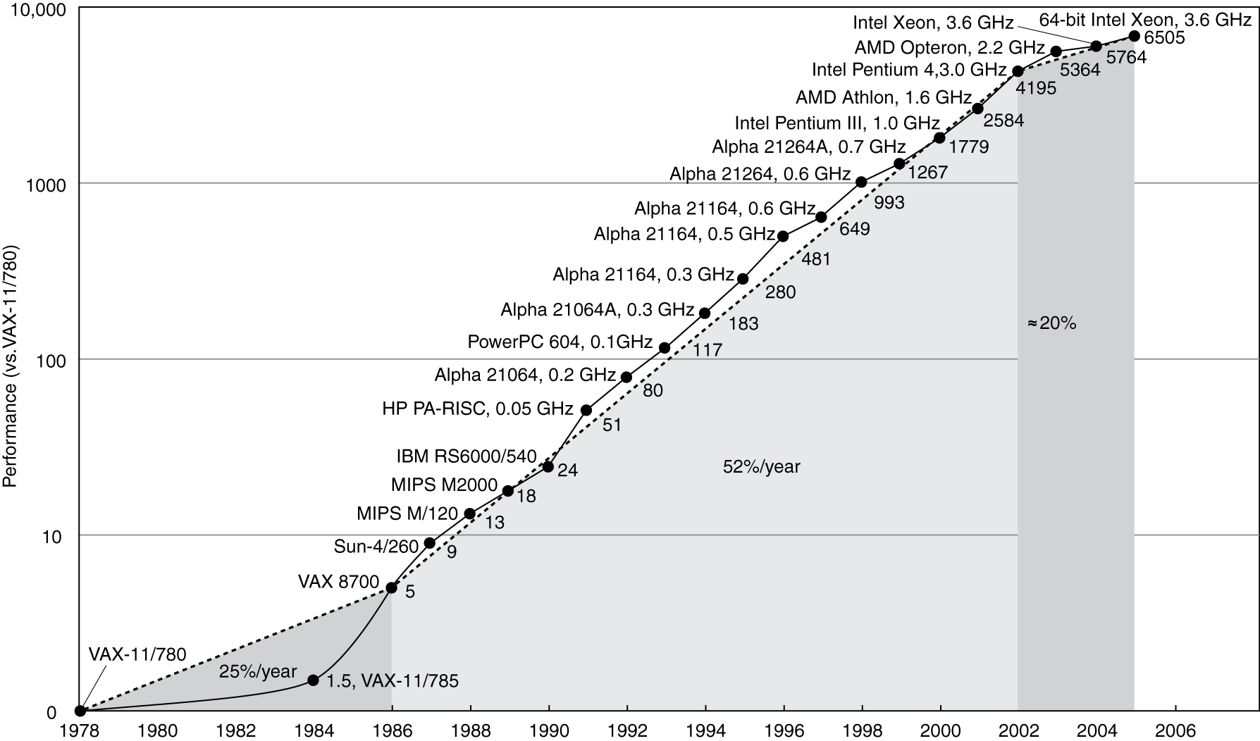
Processor Performance (1978-2005)
Slowed down by power and memory latency
Almost 10000x improvement between 1978 and 2005

Slide 22
Microprocessor Sales (1998 – 2002)
ARM processor sales exceeded Intel IA-32 processors, which came second
ARM processors are used mostly in cellular phones
Most processors today are embedded in cell phones, digital TVs, video games, and a variety of consumer devices

Slide 23
Classes of Computers
Desktop / Notebook Computers
  General purpose, variety of software
  Subject to cost/performance tradeoff
Server Computers
  Network based
  High capacity, performance, reliability
  Range from small servers to building sized
Embedded Computers
  Hidden as components of systems
  Stringent power/performance/cost constraints

Slide 24
Computer Sales (1998 – 2002)

Slide 25
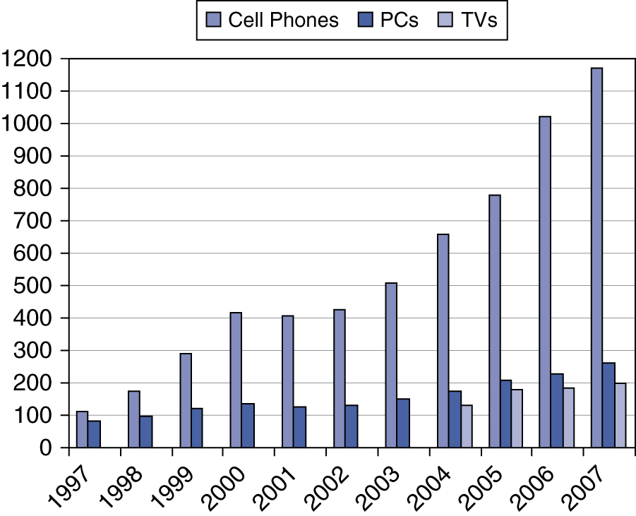

The Processor Market (1997-2007)

Slide 26
Chip Manufacturing Process
Silicon ingot
Blank wafers
Slicer
Hundreds of Steps
30 cm diameter
1 mm thick
Tested dies
Individual dies
Patterned wafer
Die
Tester
Dicer
Packaged dies
Tested Packaged dies
Bond die to
package
Part
Tester
Ship to
Customers

Slide 27
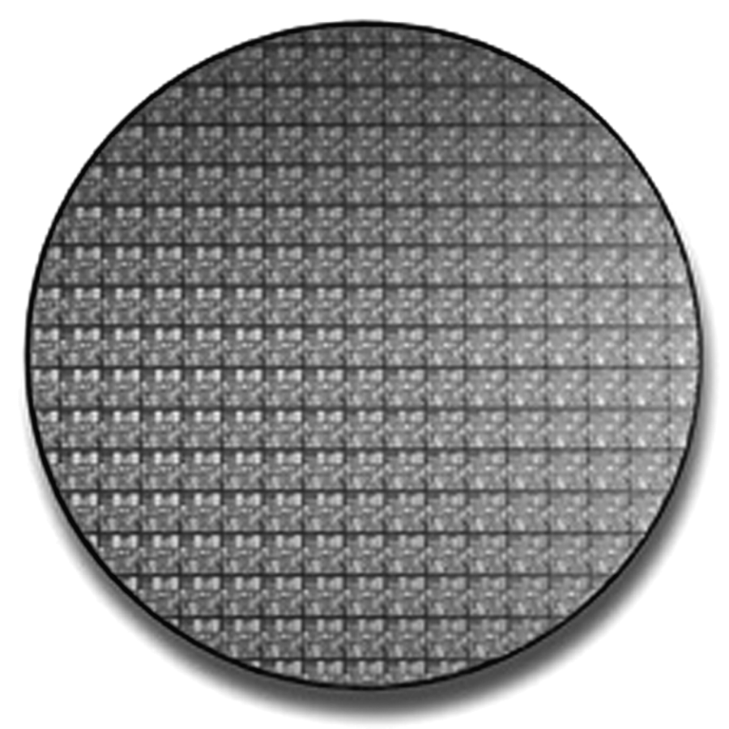
Wafer of Pentium 4 Processors
8 inches (20 cm) in diameter
Die area is 250 mm²
  About 16 mm per side
55 million transistors per die
  0.18 μm technology
  Size of smallest transistor
  Improved technology uses
    0.13 μm and 0.09 μm
Dies per wafer = 169
  When yield = 100%
  Number is reduced after testing
  Rounded dies at boundary are useless

Slide 28
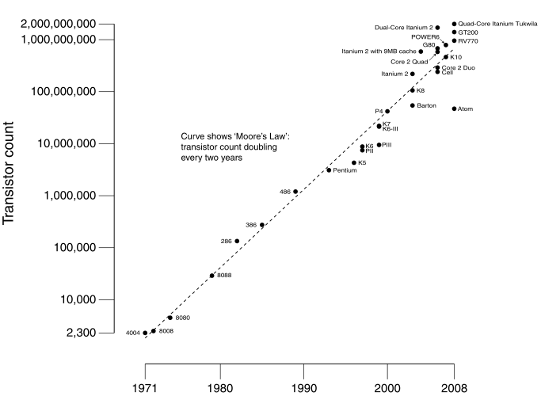
CPU Transistor Count (1971 – 2008)
10-Core Xeon Westmere-EX introduced in 2011 has 2.6 billion transistors and uses a 32 nm process on a die size = 512 mm²

Slide 29
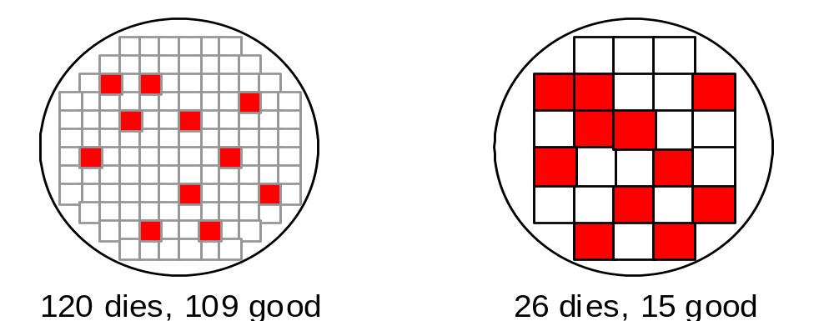
Effect of Die Size on Yield
Good Die
Defective Die
Dramatic decrease in yield with larger dies
Yield = (Number of Good Dies) / (Total Number of Dies)
1
Yield =
(1 + (Defect per area × Die area / 2))²
Die Cost = (Wafer Cost) / (Dies per Wafer × Yield)

Slide 30
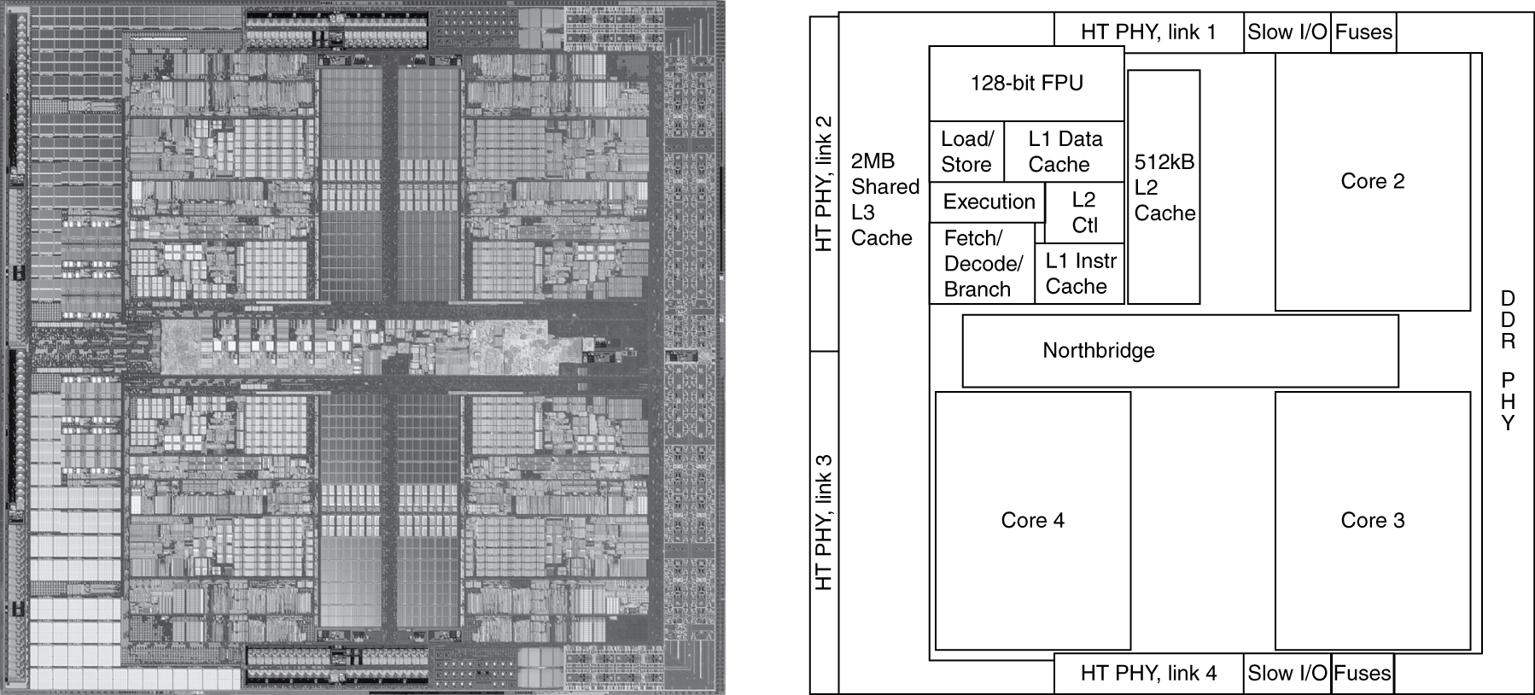
Inside a Multicore Processor Chip
AMD Barcelona: 4 Processor Cores
3 Levels of Caches

Slide 31
Course Roadmap
Instruction set architecture (Chapter 2)
Computer arithmetic (Chapter 3)
Performance issues (Chapter 4)
Constructing a processor (Chapter 5)
Pipelining to improve performance (Chapter 6)
Memory: caches and virtual memory (Chapter 7)
Introduction to Parallel Architectures
Key to obtain a good grade: read the textbook!

